Slide 1
Case Study
Sneha is a confident 25-year old woman, presently employed in a large multi-national company. She has been in a relationship since the past four years with Nitin, who had been her classmate in school.
She described him as “protective, very concerned about her welfare and her decisions” and though living in different cities now since the past one year, owing to their jobs, he was constantly involved in all aspects of her life – ranging from decisions related to her career moves, to whom she should meet and interact at work, and to what her appropriate attire should be on various occasions.

Slide 2
A few months ago, when she was selected by her organization for an assignment abroad, he flew down to supervise her travel preparations and her itinerary, despite all such arrangements being made by her company.
His last-minute instructions comprised the exact timings of phone calls she should make to him when she was abroad. Once, when they were living in the same city, he had walked in into her office, unannounced, and when he found that she was not wearing the dress that he had instructed, went into a rage, and began to yell at her.

Slide 3
He immediately apologized and was more careful thereafter for a few days, and so she decided not to take the issue seriously.
On his first visit to her new office in a different city, his immediate reaction was reportedly dismay at the sight of so many young male colleagues. He left after giving her a series of instructions about how she should behave with them at the workplace including advice on refraining from social interactions with them beyond work. All this was supposedly because she “did not know how men were”!

Slide 4
Once she had inadvertently left her apartment door unlocked, and though nothing untoward had happened, not only did he repeatedly advise her to put on a self-closing lock and so on, but also used this incident to prove his point that she was not yet capable of looking after herself. Even at her work, she was advised not to take up a promotion because he felt she was still “immature” and not capable of discharging responsibilities required in handling such jobs.

Slide 5
Her decision to move to another city was not unexpectedly, met with stiff opposition. He started checking on her whenever he felt like, in the name of concern for her welfare. She began to live in constant dread of his unexpected visits or frequent phone calls and forever wondering whether she would be ‘caught’ for doing ‘something wrong’.

Slide 6
Nitin did not have any problems in his work place, was showing promising signs of upward mobility in his own career, had a wide circle of friends, and was in general, “cheerful, witty, and smart” – qualities that she had initially found charming.
Furthermore, because of his appealing qualities otherwise, Sneha attributed the difficulties in their relationship to her own “immaturity and deficiencies”.

Slide 7
Question for discussion
How would you describe the behavior of Nitin?

Slide 8

Violence against women and links with masculinities
Module 3

Slide 9
Definitions of Violence against women
Any act of gender-based violence that results in, or likely to result, in physical, sexual or mental harm or suffering to women, including threats of such acts, coercion or arbitrary deprivation of liberty, whether occurring in private or public life”
[Article 1, DEVAW, UN, 1993]
Violence “that is directed against a woman because she is a woman or that affects women disproportionately”
[Article 3, CEDAW, 1979]

Slide 10
Continuum of violence
Control
[e.g., jealousy, sulking, ultimatums]
Abuse
[threats of violence & intimidation]
Battering
[direct physical aggression]
Violent acts and other forms of controlling behaviours
Manifestations of masculinities

Slide 11
Forms of violence
Physical
Sexual
Verbal
Economic
Emotional/Psychological

Slide 12
Forms of VAW
Physical Abuse
Physical assaults and threats to control another person
Sexual Abuse
Mistreatment or control of partner sexually
Includes punching, hitting, choking, biting, throwing objects, kicking, pushing and using weapon
Includes demands for sex using coercion or the performance of certain sexual acts, forcing her to have sex with other people, insisting on unsafe sex.

Slide 13
Forms of VAW
Verbal Abuse
Mistreatment and undermining of partner's self-worth to control her. Includes criticism, threats, insults, belittling comments and manipulation
Psychological Abuse
Tactics to isolate and undermine partner's self esteem causing her to be more dependent on & frightened of abuser. Includes such acts as:
Isolating her from her family and friends
Threatening to harm people and things she loves
Constantly checking up on her

Slide 14
Economic
Refusing to allow the woman to work outside the home
Withholding money or access to money

Slide 15
VAW a structural problem, not simply a random or individual act
Manifestation of historically unequal power relations
Functions as social mechanism for enforcing & sustaining gender inequality
Perpetuated by rigid socio-cultural expectations about gender roles and about masculinity
Constitutes a form of human rights violation: to life, liberty, dignity, bodily integrity

Slide 16
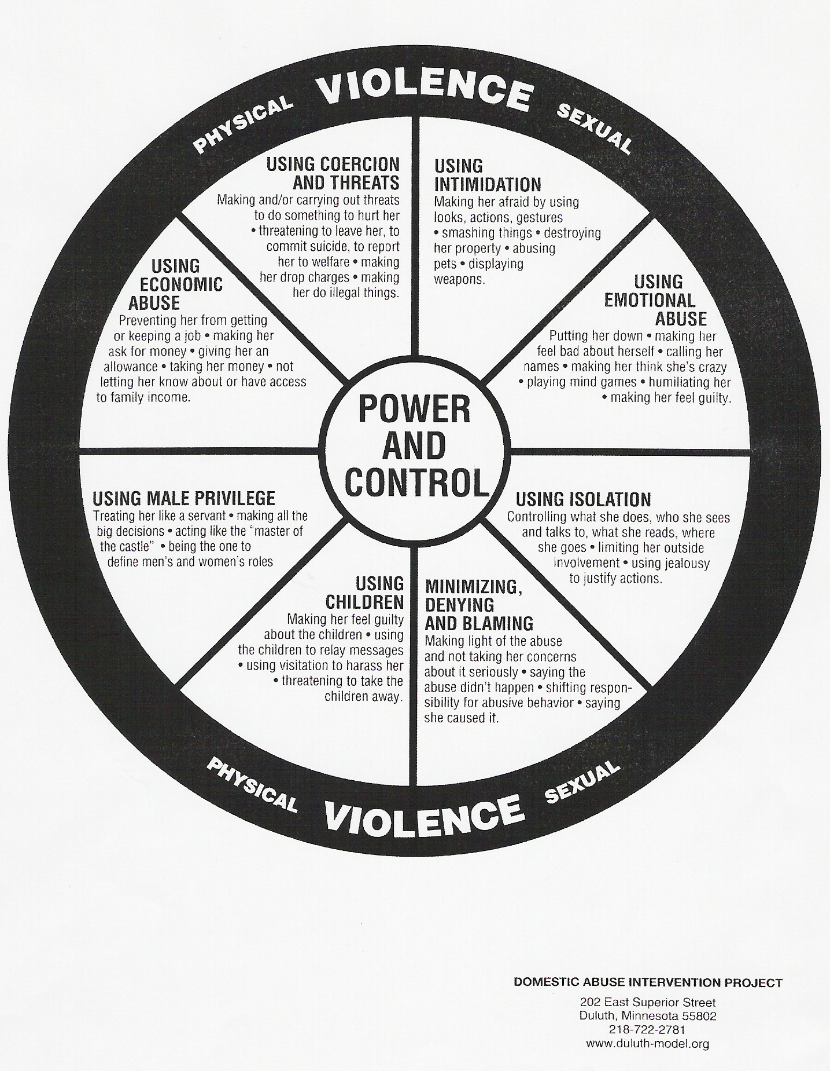

Slide 17
Myths and facts about gender-based violence

Slide 18
Myth
Fact
Conflicts and losing control are a normal part of any relationship.
Violence is not about “losing” control – it is about “gaining” control through threats, intimidation, and violence
Violence in a relationship is not normal - it is a manifestation of historically unequal power relations between men and women

Slide 19
Myth
Fact
Domestic violence is a private family matter, in which the state has no right to intervene. How a man treats his wife is a private matter.
Violence against women is a human rights violation, no matter whether it occurs in the family or in the public sphere.

Slide 20
Stereotypes about Sexual violence
Victim-blaming – she is the ‘cause’ herself , while normalizing the behavior of perpetrator
Victim provocation (e.g., “ she was scantily dressed; she was out late at night”)
Victim fabrication (e.g., “she lied”)
Male justification (e.g., “he didn't mean to”)

Slide 21
Why be aware of myths associated with VAW?
Myths are stereotypical attitudes that are harmful because they blame the survivor and not the perpetrator
Myths also lead to normalization of violence
Need to distinguish between myths and facts to maintain gender-sensitive attitude

Slide 22
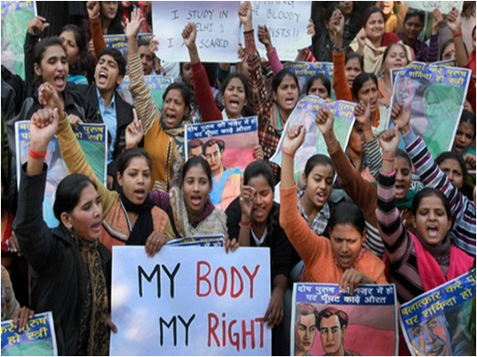
VAW: Most visible indicator of gender inequality or patriarchy
Increase in reported VAW
Gap between reporting and conviction rate
But shift from cultural codes of shame and honour in sexual violence to framework of constitutional guarantees of rights

Slide 23

Social and cultural sanction to VAW rooted in dominant form of masculinity
Violence stems from beliefs and actions that are products of socialization
“Boys should be tough, girls should be soft”
“Its ok if your husband hits you, he is your husband after all
Motivation is to gain power and control
Origins in socialization processes of
Acceptance of violence against women
Virility
Protection of family/community ‘honour’
Violence linked to masculine dominance

Slide 24
What has been done so far? Societies which are gender equal have less levels of violence
Laws/amendments and movements
Domestic violence
Sexual harassment
Rape
Female foeticide
VAW the first issue to trigger off the women’s movement in India in 1980s/1990s
Research
Causes of violence
Profiles of perpetrators and survivors
Impact of laws
Services
One stop centres
Shelter homes
Mahila police stations/Bharosa centres

Slide 25
But a long way to go -- Continuing challenges
25
Contradiction between hierarchical social order and democratic political system
Rights of citizenship vs. tradition
Mismatch between women’s and men’s roles
Engaging with boys and men essential

